Slide 1
From Fuzzy to CRISP
A Data-Driven Framework for Defence Simulation Studies with CRISP-DM
April Tieu
Operations Research Analyst (International Secondee to UK)
Defence Science & Technology Group (DSTG) / Defence Science and Technology Laboratory (Dstl)
OFFICIAL
FOR PUBLIC RELEASE

Slide 2

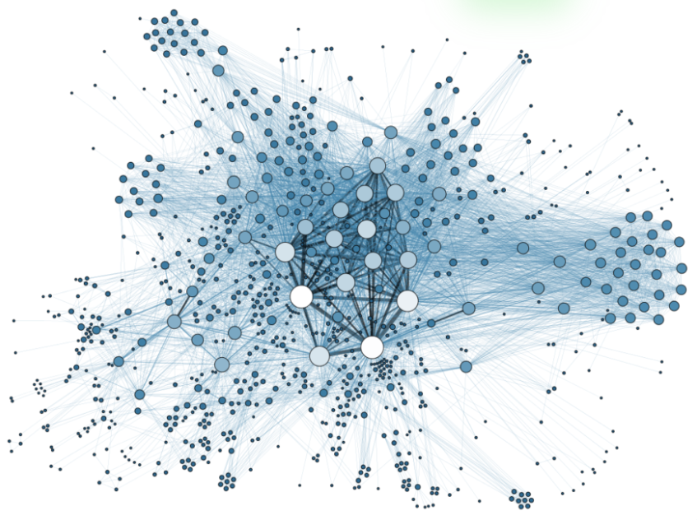






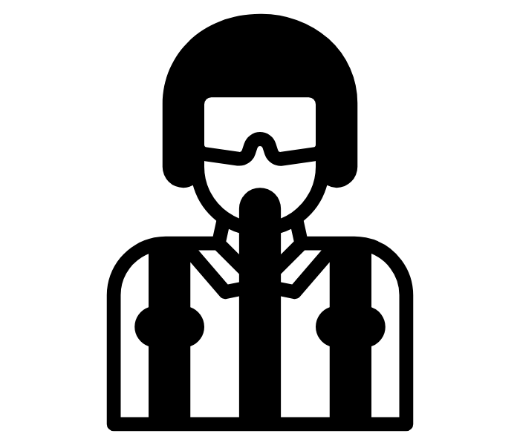
The reality of Defence simulation problems
Fuzzy problem space
Complex data landscape
Diverse stakeholder objectives
Large solution space
OFFICIAL
FOR PUBLIC RELEASE

Slide 3

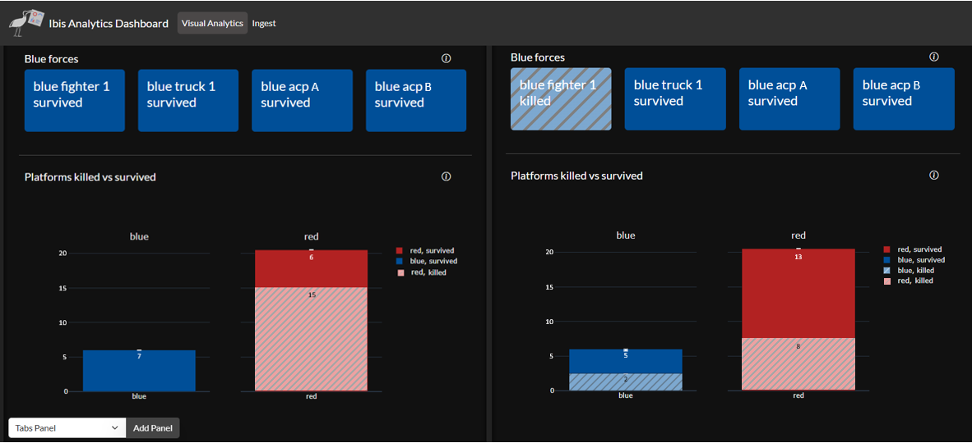
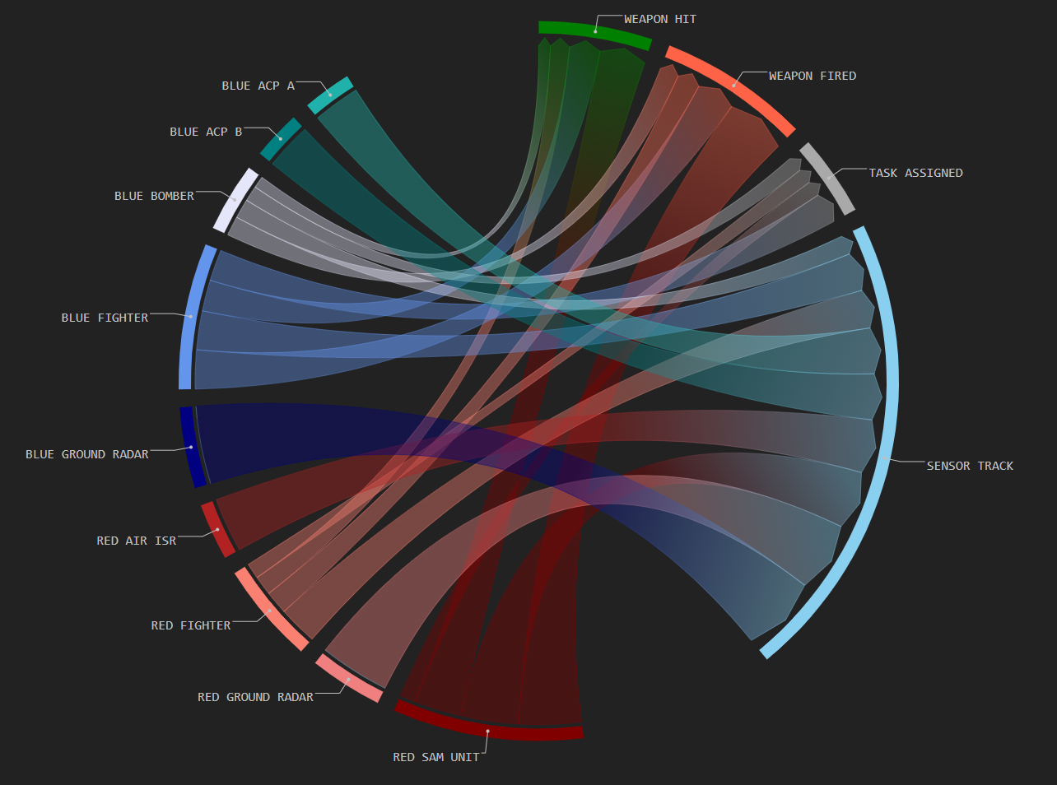
The reality of Defence simulation problems
Fuzzy problem space
Complex data landscape
Diverse stakeholder objectives
Large solution space
Actionable and visual insight
OFFICIAL
FOR PUBLIC RELEASE
Notes:
In this environment, simulation is essential, but it’s also not straightforward…
Fuzzy problem space:
- Vague project objectives
- Emerging technologies
- Incomplete or uncertain requirements
Ambiguous success criteria
Diverse stakeholder criteri
Competing priorities
Different time horizons
Varying familiarity with simulation or data
Complex data landscape
HITL + constructive + SME debrief data
Structured and unstructured data
Simulation outputs at multiple levels

Slide 4
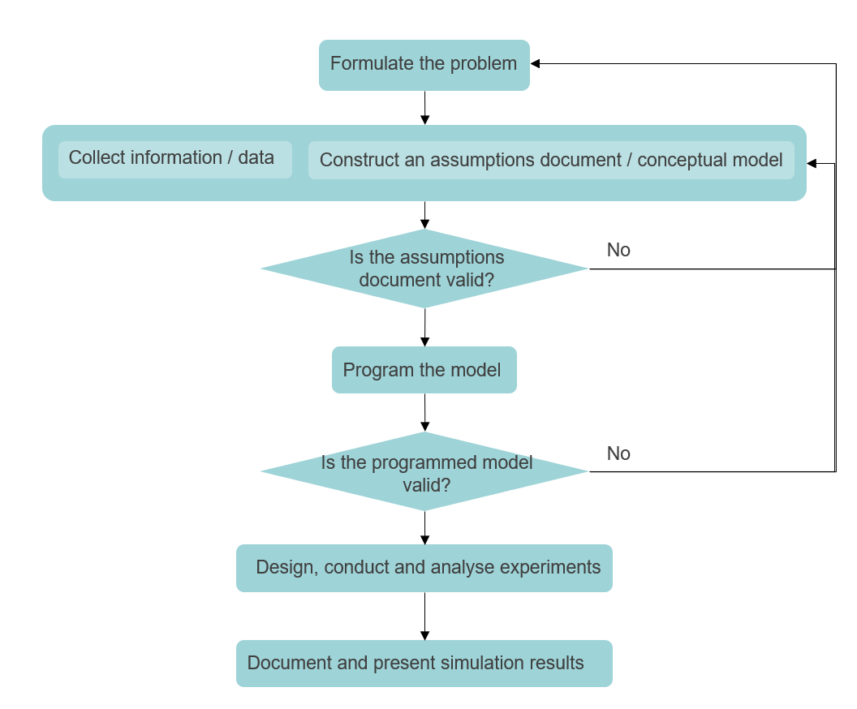
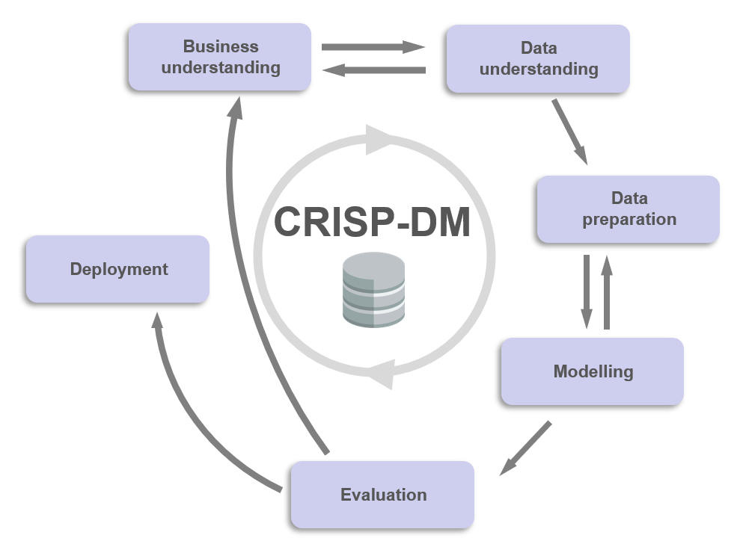
Overview
Simulation in Defence
General approach for simulation studies
CRoss Industry Standard Process for Data Mining (CRISP-DM)
Data-driven framework for Defence simulation studies
Case study: exploring autonomous collaborative platforms through simulation wargaming and visual analytics
*** This case study has been simplified and examples use dummy data
Conclusion and key takeaways
OFFICIAL
FOR PUBLIC RELEASE

Slide 5



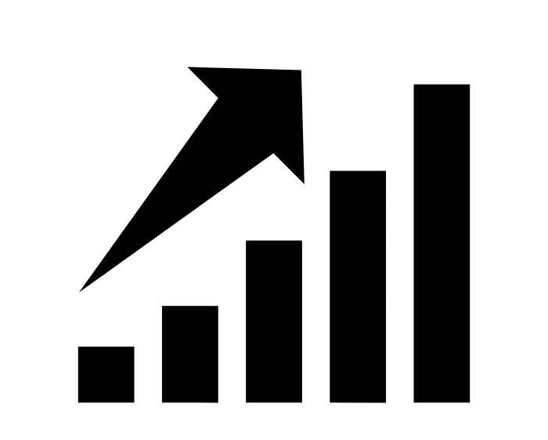
Simulation in Defence – why simulation studies?
Wargaming
Training, tactics, procedures
Operational Analysis
Test and Evaluation
Concept Development and Experimentation
Capability Assessment
and more…
Lower cost than fully live exercises
Low risk – safely test dangerous scenarios
Fast decision making and planning
Scalable to different levels of fidelity
OFFICIAL
FOR PUBLIC RELEASE

Slide 6

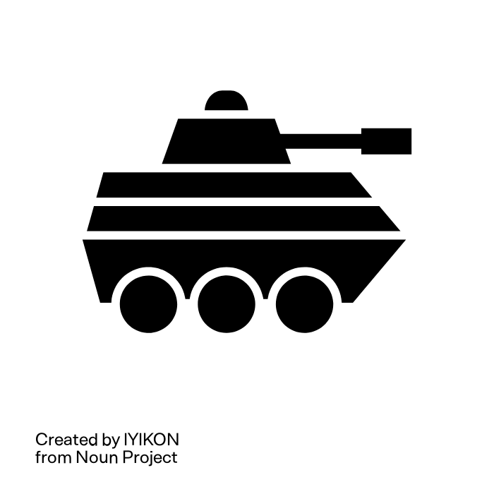



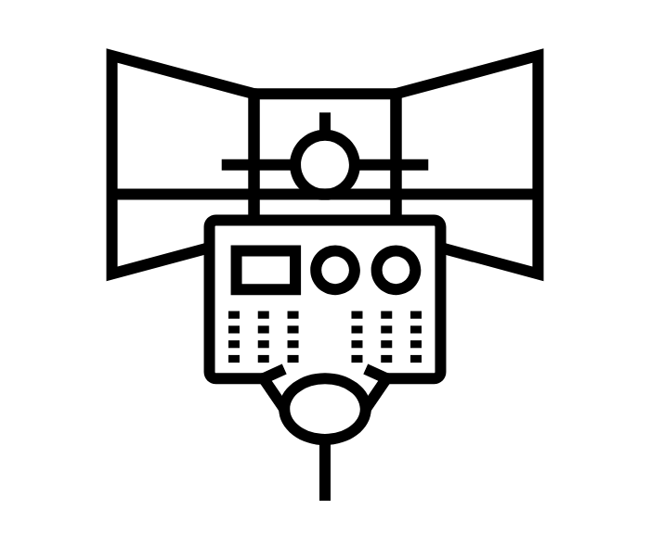





Simulation types – what kind of simulation?
Full control of systems
Live
real systems,
real people in a
real environment
LVC Taxonomy
Virtual
simulated systems,
real people in a
simulated environment
VC Hybrid
simulated systems,
simulated and real people in a
simulated environment
Constructive
simulated systems
simulated people in a simulated environment
No control of systems (automated)
OFFICIAL
FOR PUBLIC RELEASE

Slide 7
Simulation types – what kind of simulation?
Full control of systems
Live
real systems,
real people in a
real environment
LVC Taxonomy
Virtual
simulated systems,
real people in a
simulated environment
VC Hybrid
simulated systems,
simulated and real people in a
simulated environment
Constructive
simulated systems
simulated people in a simulated environment
No control of systems (automated)
OFFICIAL
FOR PUBLIC RELEASE

Slide 8
7 steps for a successful simulation study
Formulate the problem
Collect information / data
Construct an assumptions document / conceptual model
Is the assumptions document valid?
No
Program the model
Is the programmed model valid?
No
Design, conduct and analyse experiments
Document and present simulation results
Adapted from (Law, 2009)
OFFICIAL
FOR PUBLIC RELEASE

Slide 9
7 steps for a successful simulation study
Provides us with…
General guidance for designing a simulation study
  Primarily for discrete-event constructive simulation
Guidance on developing a credible and valid model specific to simulation study needs
Adapted from (Law, 2009)
OFFICIAL
FOR PUBLIC RELEASE

Slide 10

7 steps for a successful simulation study
Does not provide us with…
Choosing the simulation type. Constructive? Hybrid?
Guidance on the analysis and visualisation of simulation data outputs based on objectives
What is useful for analysis?
What patterns / insights can we get?
What can we do with the data?
What visualisations are useful?
How do we handle the qualitative data?
Adapted from (Law, 2009)
OFFICIAL
FOR PUBLIC RELEASE

Slide 11
CRISP-DM: CRoss Industry Standard Process for Data Mining
Business understanding
Data understanding
CRISP-DM
Data preparation
Deployment
Modelling
Process model for data mining projects
Cyclic and iterative
Evaluation
Adapted from Wirth & Hipp (2000)
OFFICIAL
FOR PUBLIC RELEASE

Slide 12
CRISP-DM: CRoss Industry Standard Process for Data Mining
Business understanding
Data understanding
CRISP-DM
Data preparation
Deployment
Modelling
Process model for data mining projects
Cyclic and iterative
Evaluation
Adapted from Wirth & Hipp (2000)
OFFICIAL
FOR PUBLIC RELEASE

Slide 13
CRISP-DM: CRoss Industry Standard Process for Data Mining
Business understanding
Data understanding
CRISP-DM
Data preparation
Deployment
Modelling
Process model for data mining projects
Cyclic and iterative
Evaluation
Adapted from Wirth & Hipp (2000)
OFFICIAL
FOR PUBLIC RELEASE

Slide 14
CRISP-DM: CRoss Industry Standard Process for Data Mining
Business understanding
Data understanding
CRISP-DM
Data preparation
Deployment
Modelling
Process model for data mining projects
Cyclic and iterative
Evaluation
Adapted from Wirth & Hipp (2000)
OFFICIAL
FOR PUBLIC RELEASE

Slide 15
CRISP-DM: CRoss Industry Standard Process for Data Mining
Business understanding
Data understanding
CRISP-DM
Data preparation
Deployment
Modelling
Process model for data mining projects
Cyclic and iterative
Evaluation
Adapted from Wirth & Hipp (2000)
OFFICIAL
FOR PUBLIC RELEASE

Slide 16
CRISP-DM: CRoss Industry Standard Process for Data Mining
Business understanding
Data understanding
CRISP-DM
Data preparation
Deployment
Modelling
Process model for data mining projects
Cyclic and iterative
Evaluation
Adapted from Wirth & Hipp (2000)
OFFICIAL
FOR PUBLIC RELEASE

Slide 17
CRISP-DM: CRoss Industry Standard Process for Data Mining
Business understanding
Data understanding
CRISP-DM
Data preparation
Deployment
Modelling
Process model for data mining projects
Cyclic and iterative
Evaluation
Adapted from Wirth & Hipp (2000)
OFFICIAL
FOR PUBLIC RELEASE

Slide 18
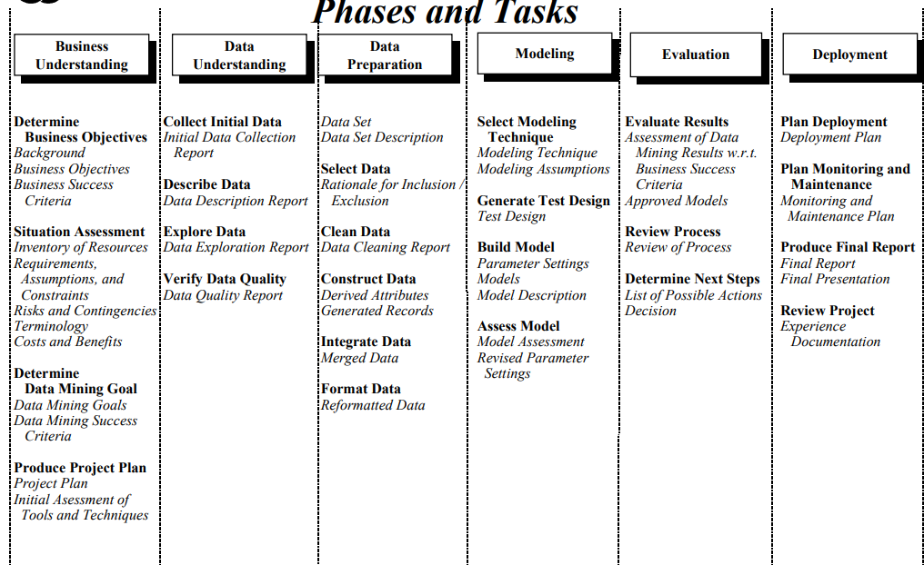
CRISP-DM: CRoss Industry Standard Process for Data Mining
Chapman (2000)
OFFICIAL
FOR PUBLIC RELEASE

Slide 19
CRISP-DM: CRoss Industry Standard Process for Data Mining
Provides us with…
Guidance on the analysis and visualisation of data based on objectives
What is useful for analysis?
What patterns / insights can we get?
What can we do with the data?
What visualisations are useful?
How do we handle the qualitative data?
Detailed guidance on conducting a data mining project
OFFICIAL
FOR PUBLIC RELEASE

Slide 20
CRISP-DM: CRoss Industry Standard Process for Data Mining
Does not provide us with …
Consideration of specific Defence simulation study needs e.g., programming the model, choosing type of simulation
Application to other types of data projects e.g., qualitative data from Human-in-the-loop
OFFICIAL
FOR PUBLIC RELEASE

Slide 21
The problem:
Gap between simulation process and data-driven insight
Adapted from (Law, 2009)
Great for building valid and credible simulations
Great for data analysis and extracting insights
OFFICIAL
FOR PUBLIC RELEASE

Slide 22
The problem:
Gap between simulation process and data-driven insight
No unified process to guide analysts from fuzzy problems to actionable insights
Adapted from (Law, 2009)
Great for building valid and credible simulations
Great for data analysis and extracting insights
OFFICIAL
FOR PUBLIC RELEASE

Slide 23
The problem:
Gap between simulation process and data-driven insight
No unified process to guide analysts from fuzzy problems to actionable insights
Adapted from (Law, 2009)
We need a framework that connects simulation design with structured data analysis
Great for building valid and credible simulations
Great for data analysis and extracting insights
OFFICIAL
FOR PUBLIC RELEASE

Slide 24
Data-driven framework for Defence simulation studies
Business understanding
Data understanding
Data preparation
Deployment
Modelling & Analysis
Evaluation
OFFICIAL
FOR PUBLIC RELEASE

Slide 25
Data-driven framework for Defence simulation studies
Business understanding
Formulate the problem
Define data analysis objectives
Determine type of simulation (LVC)
Determine business objectives
Data understanding
Collect initial data
Design simulation experiment (DOE)
Run simulation
Data preparation
Construct assumptions document
Integrate, format and merge data
Deployment
Modelling & Analysis
Present results
Develop simulation model
Develop visual model and visualisations
Develop meta-model
Evaluation
Validate, verify and assess models
Assess results against objectives
Simplified version of our framework, the tasks in blue boxes are not exhaustive
OFFICIAL
FOR PUBLIC RELEASE

Slide 26
Data-driven framework for Defence simulation studies
Business understanding
Formulate the problem
Define data analysis objectives
Determine type of simulation (LVC)
Determine business objectives
Data understanding
Collect initial data
Design simulation experiment (DOE)
Run simulation
Data preparation
Construct assumptions document
Integrate, format and merge data
Deployment
Modelling & Analysis
Present results
Develop simulation model
Develop visual model and visualisations
Develop meta-model
Evaluation
Validate, verify and assess models
Assess results against objectives
Simplified version of our framework, the tasks in blue boxes are not exhaustive
OFFICIAL
FOR PUBLIC RELEASE

Slide 27
Case study:
Exploring autonomous platforms through simulation wargaming and visual analytics
Business understanding
High-level goals of the project – the “why”
Understand how we can employ ACPs* to support and enable specific mission types**
Collaborate with international partners to improve an existing simulation software capability
Formulate the problem
Define data analysis objectives
Determine type of simulation (LVC)
Determine business objectives
* ACP = autonomous collaborative platform
** Specific mission types are not included in this simplified description
OFFICIAL
FOR PUBLIC RELEASE

Slide 28
Case study:
Exploring autonomous platforms through simulation wargaming and visual analytics
Business understanding
High-level goals of the project – the “why”
Understand how we can employ ACPs* to support and enable specific mission types**
Collaborate with international partners to improve an existing simulation software capability
Formulate the problem
Define data analysis objectives
Determine type of simulation (LVC)
Determine business objectives
Question(s) that needs to be addressed – the “what”
How do the mission performance metrics vary across ACP employment concepts?
How are the ACP employment concepts influenced by force structure (e.g., number and type of ACPs)?
* ACP = autonomous collaborative platform
** Specific mission types are not included in this simplified description
OFFICIAL
FOR PUBLIC RELEASE

Slide 29



Case study:
Exploring autonomous platforms through simulation wargaming and visual analytics
Business understanding
High-level goals of the project – the “why”
Understand how we can employ ACPs* to support and enable specific mission types**
Collaborate with international partners to improve an existing simulation software capability
Formulate the problem
Define data analysis objectives
Determine type of simulation (LVC)
Determine business objectives
Question(s) that needs to be addressed – the “what”
How do the mission performance metrics vary across ACP employment concepts?
How are the ACP employment concepts influenced by force structure (e.g., number and type of ACPs)?
The outcomes of analysis
Collect qualitative data (descriptions) on different ACP* employment concepts
Quantify the contribution of ACPs on the kill chain
Quantify the impact of ACPs on mission outcomes (e.g., success rate, survivability, time to target)
* ACP = autonomous collaborative platform
** Specific mission types are not included in this simplified description
OFFICIAL
FOR PUBLIC RELEASE

Slide 30
Case study:
Exploring autonomous platforms through simulation wargaming and visual analytics
Business understanding
High-level goals of the project – the “why”
Understand how we can employ ACPs* to support and enable specific mission types
Collaborate with international partners to improve an existing simulation software capability
Formulate the problem
Define data analysis objectives
Determine type of simulation (LVC)
Determine business objectives
Question(s) that needs to be addressed – the “what”
How do the mission performance metrics vary across ACP employment concepts?
How are the ACP employment concepts influenced by force structure (e.g., number and type of ACPs)?
Simulation wargaming event
Human-in-the-loop (virtual) for exploration of ACP employment concepts
  Players control some aspects of fighters and ACPs (e.g., go to location, fire weapon)
The outcomes of analysis
Collect qualitative data (descriptions) on different ACP* employment concepts
Quantify the contribution of ACPs on the kill chain
Quantify the impact of ACPs on mission outcomes (e.g., success rate, survivability, time to target)
VC Hybrid
simulated systems,
simulated and real people in a
simulated environment
OFFICIAL
FOR PUBLIC RELEASE

Slide 31
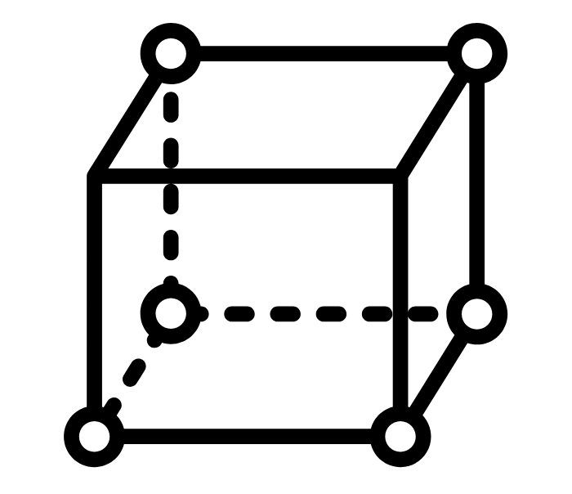
Case study:
Exploring autonomous platforms through simulation wargaming and visual analytics
Business understanding
Data understanding
Collect initial data
Design simulation experiment (DOE)
Run simulation
Factors
Number of ACPs
Type of ACPs
Distribution of ACPs across fighters
Human-in-the-loop (virtual)
Baseline run: no ACPs
8 design points*, 2 runs each (2 teams of players)
Space-filling design → exploration
Get two different employment concepts for each design point
*Design point = specific combination of factors and levels
e.g., DP1 = 1 EW ACP, 2 ISR ACPs | DP2 = 2 EW ACPs, 3 ISR ACPs
OFFICIAL
FOR PUBLIC RELEASE

Slide 32
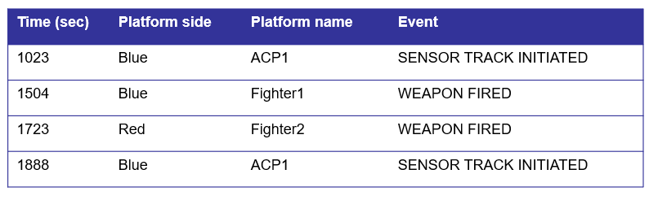
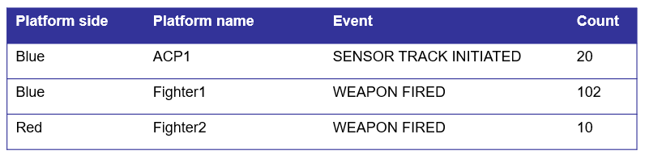
Case study:
Exploring autonomous platforms through simulation wargaming
Business understanding
Data understanding
Data preparation
Construct assumptions document
Integrate, format and merge data
Descriptions of different ACP employment concepts
ACP employment concept 1
ACP employment concept 2
…
Count number of event contributions for each platform and transform raw data
OFFICIAL
FOR PUBLIC RELEASE

Slide 33

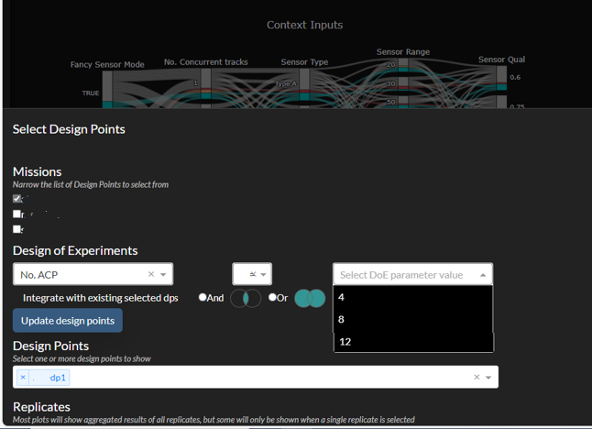
Case study:
Exploring autonomous platforms through simulation wargaming
Business understanding
Data understanding
Data preparation
Modelling & Analysis
Develop simulation model
Develop visual model and visualisations
Develop meta-model
Ibis
Visual analytics tool for simulation studies
OFFICIAL
FOR PUBLIC RELEASE

Slide 34
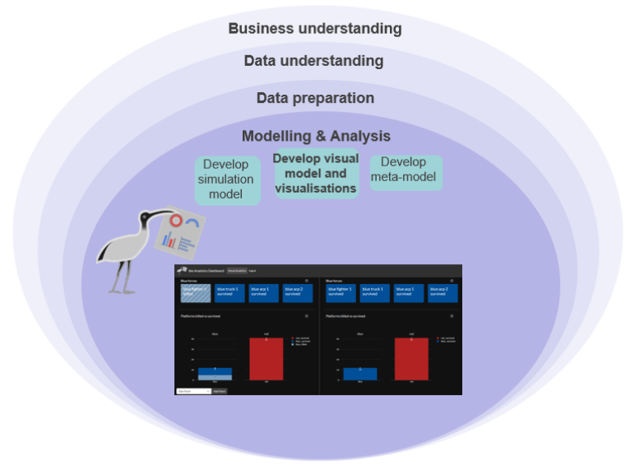
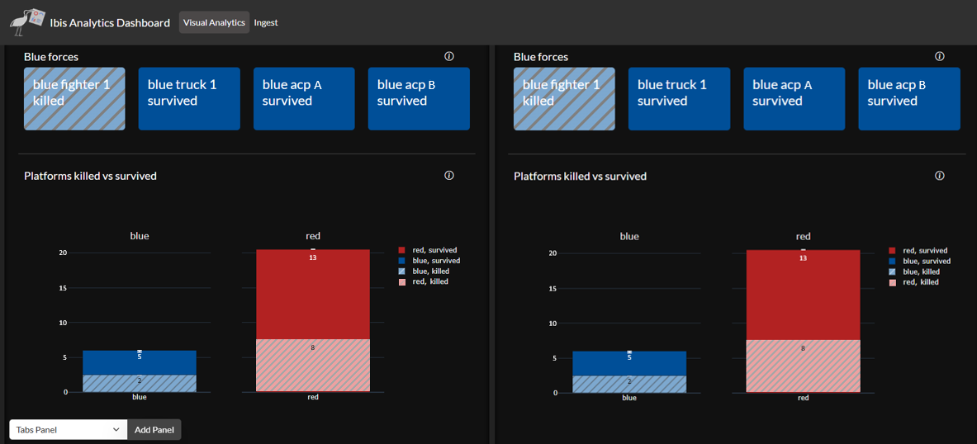
Case study:
Exploring autonomous platforms through simulation wargaming
Overview metrics
Baseline
ACP employment concept 1
The outcomes of analysis
Collect qualitative data (descriptions) on different ACP* employment concepts
Quantify the contribution of ACPs on the kill chain
Quantify the impact of ACPs on mission outcomes (e.g., success rate, survivability, time to target)
OFFICIAL
FOR PUBLIC RELEASE

Slide 35
Case study:
Exploring autonomous platforms through simulation wargaming
ACP employment concept 1 had no change in the success metrics
Overview metrics
Baseline
ACP employment concept 1
OFFICIAL
FOR PUBLIC RELEASE

Slide 36
Case study:
Exploring autonomous platforms through simulation wargaming
Overview metrics
ACP employment concept 2
Baseline
ACP employment concept 1
OFFICIAL
FOR PUBLIC RELEASE

Slide 37
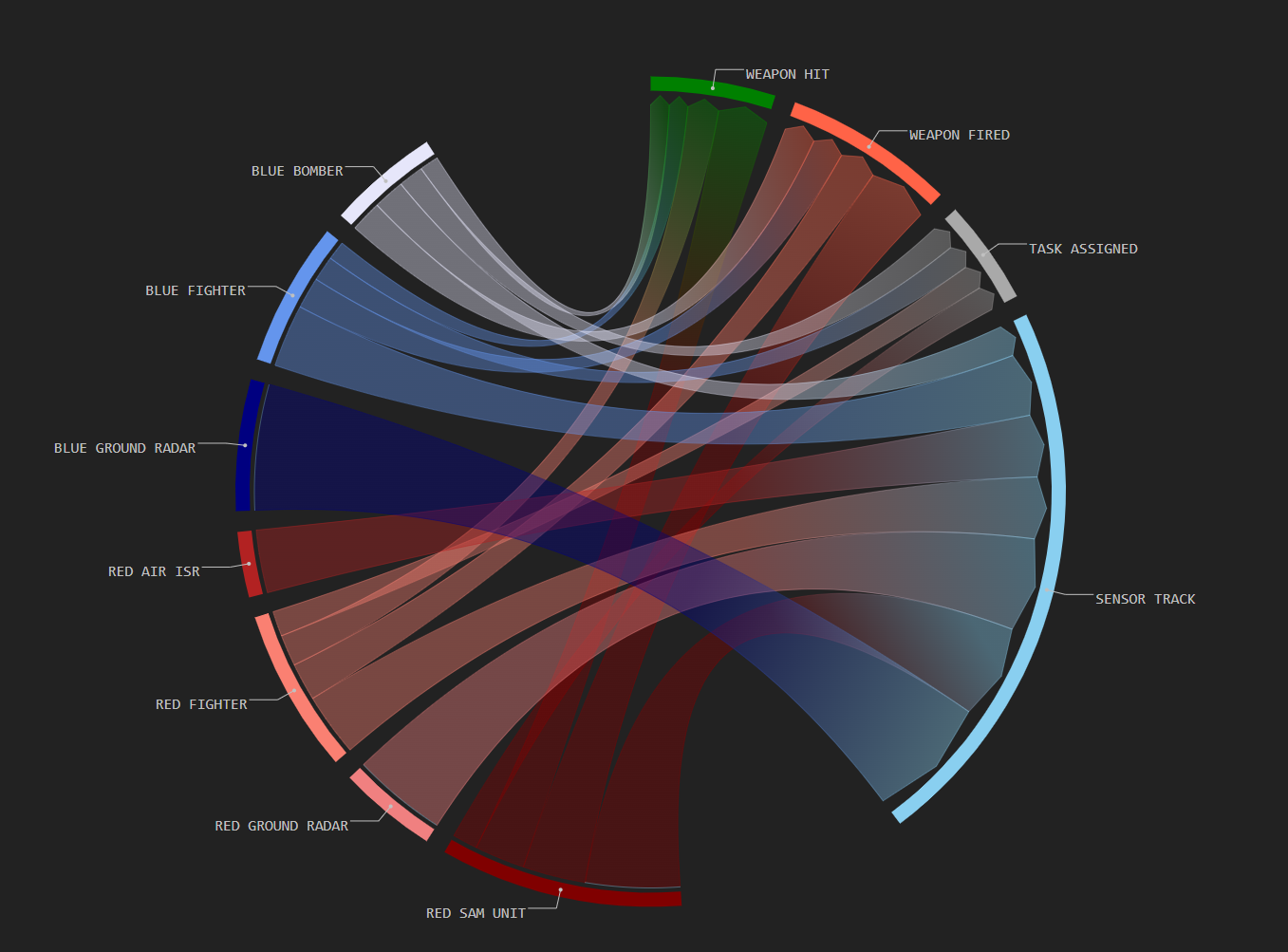
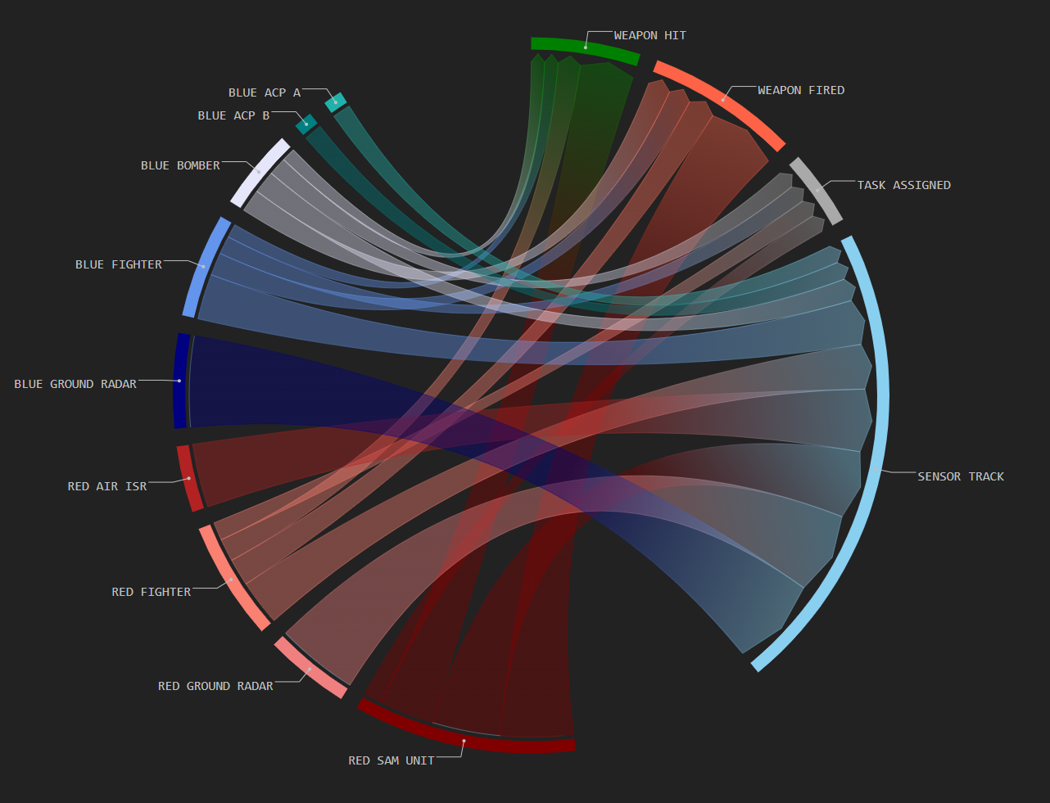
Case study:
Exploring autonomous platforms through simulation wargaming
Platform contribution
Baseline
ACP employment concept 1
The outcomes of analysis
Collect qualitative data (descriptions) on different ACP* employment concepts
Quantify the contribution of ACPs on the kill chain
Quantify the impact of ACPs on mission outcomes (e.g., success rate, survivability, time to target)
OFFICIAL
FOR PUBLIC RELEASE

Slide 38
Case study:
Exploring autonomous platforms through simulation wargaming
Platform contribution
Baseline
ACP employment concept 1
OFFICIAL
FOR PUBLIC RELEASE

Slide 39
Case study:
Exploring autonomous platforms through simulation wargaming
Platform contribution
Baseline
ACP employment concept 1
OFFICIAL
FOR PUBLIC RELEASE

Slide 40
Case study:
Exploring autonomous platforms through simulation wargaming
Platform contribution
Baseline
ACP employment concept 1
Events
Platforms
OFFICIAL
FOR PUBLIC RELEASE

Slide 41
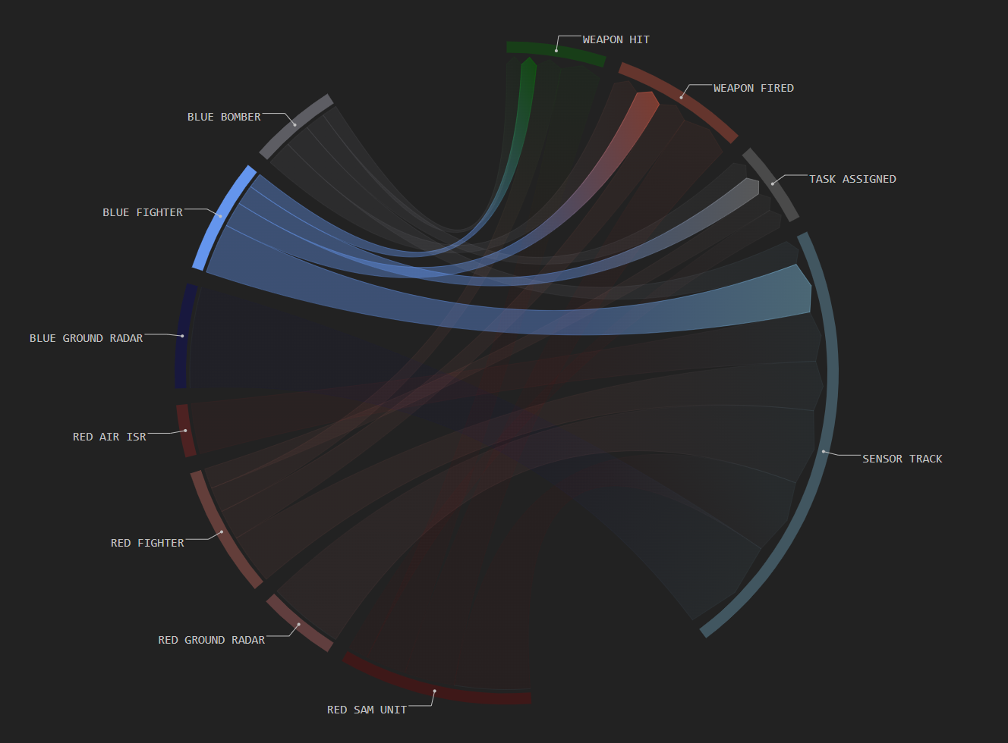
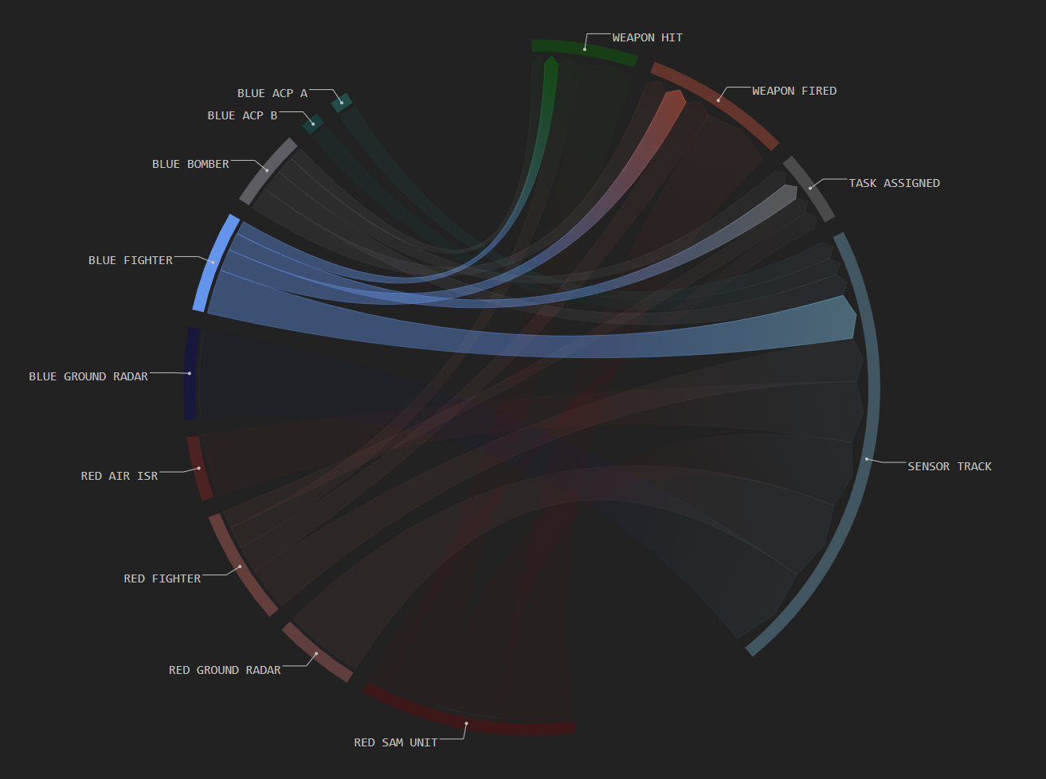
Case study:
Exploring autonomous platforms through simulation wargaming
Platform contribution
Baseline
ACP employment concept 1
OFFICIAL
FOR PUBLIC RELEASE

Slide 42
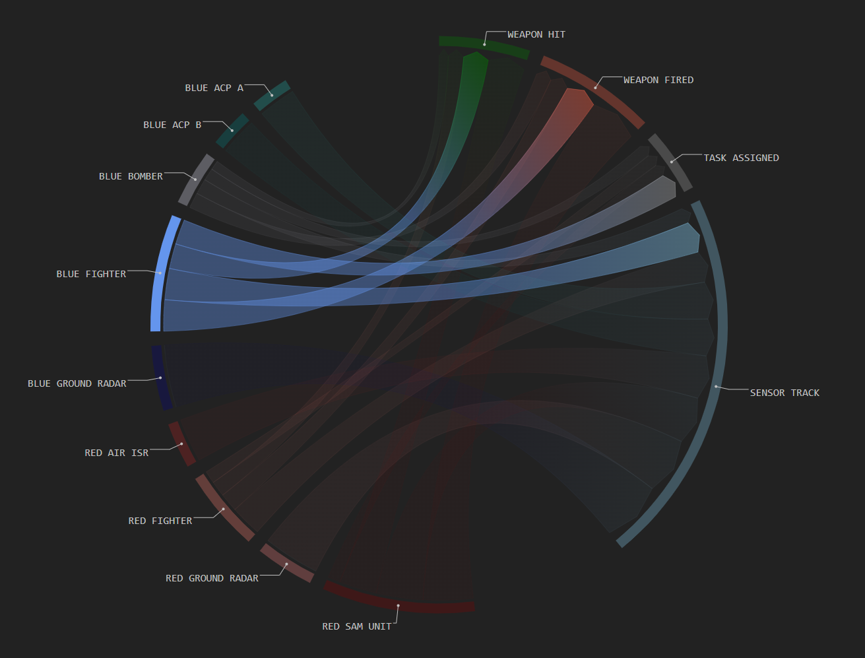
Case study:
Exploring autonomous platforms through simulation wargaming
Platform contribution
ACP employment concept 2
ACP employment concept 1
Baseline
OFFICIAL
FOR PUBLIC RELEASE

Slide 43
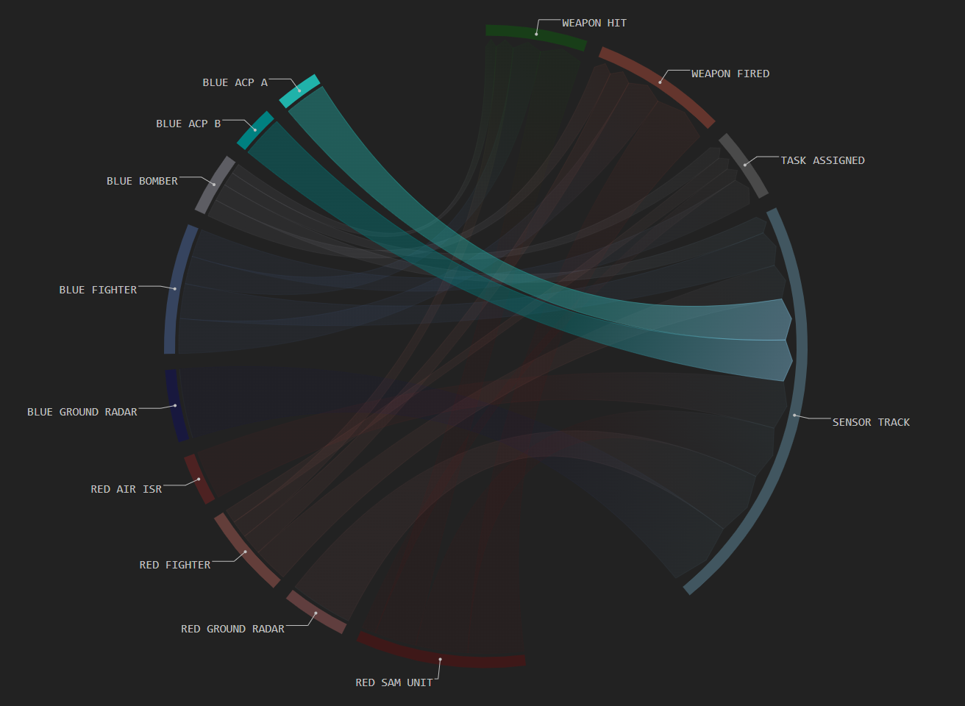
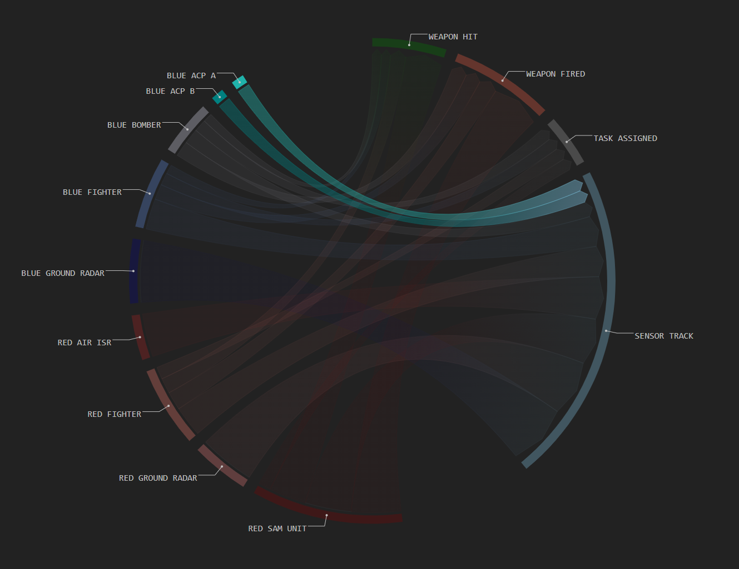
Case study:
Exploring autonomous platforms through simulation wargaming
Platform contribution
ACP employment concept 2
ACP employment concept 1
OFFICIAL
FOR PUBLIC RELEASE

Slide 44
Case study:
Exploring autonomous platforms through simulation wargaming
Platform contribution
ACP employment concept 2
ACP employment concept 1
OFFICIAL
FOR PUBLIC RELEASE

Slide 45
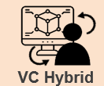
Case study: Results and Impact
Exploring autonomous platforms through simulation wargaming
Translated diverse business objectives into data objectives, simulation requirements & visual insight
Design of experiments enabled efficient use of limited human-in-the-loop runs
Visualisations not only allowed for analysis but also prompted discussion of ACP tactics
Collected qualitative data (descriptions) on different ACP employment concepts and quantitative data on mission performance
OFFICIAL
FOR PUBLIC RELEASE

Slide 46
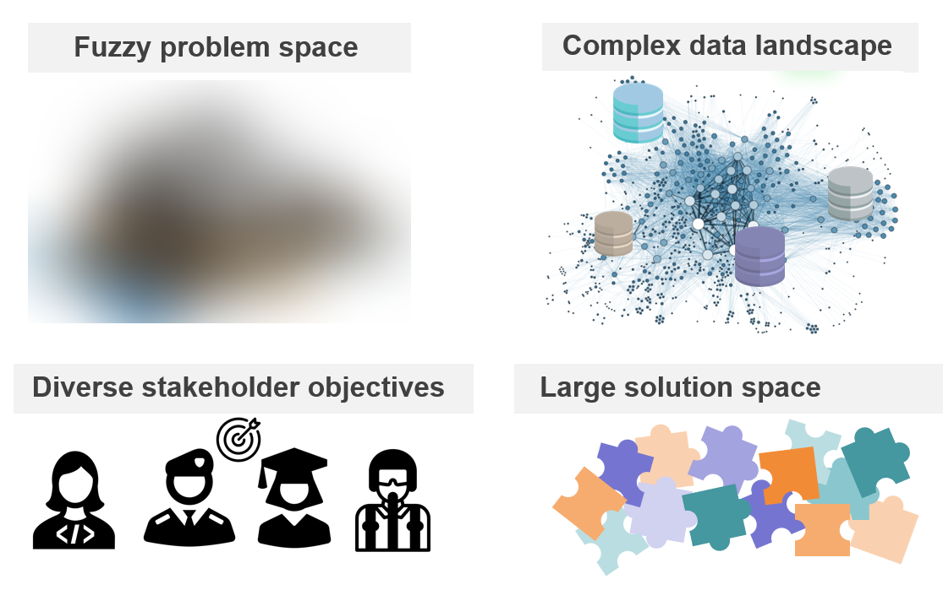
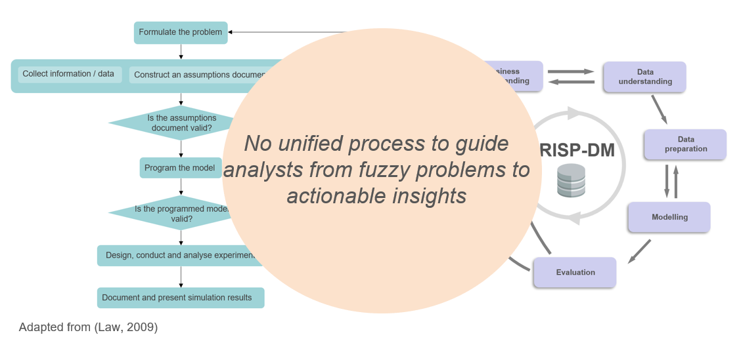
Key takeaways
Real-world Defence simulation problems are messy, multi-dimensional and often ill-defined (fuzzy)
OFFICIAL
FOR PUBLIC RELEASE

Slide 47
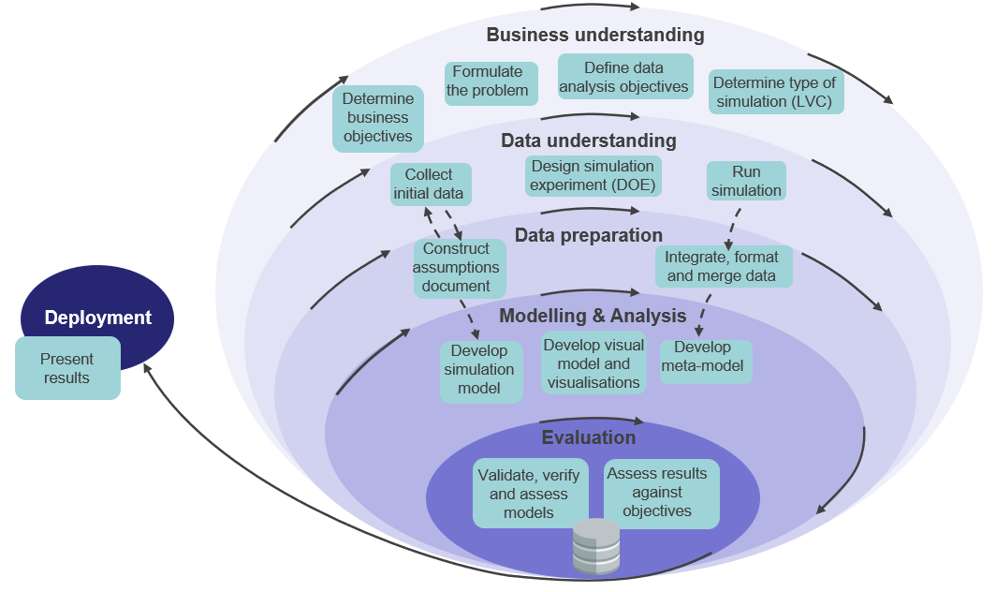
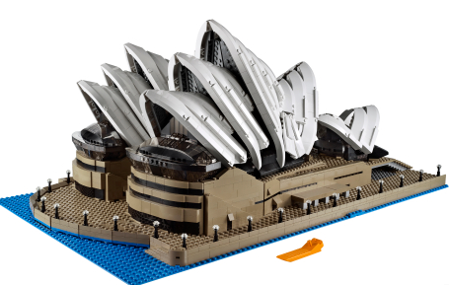
Key takeaways
From vague questions to visual insight
A data-driven framework to go from fuzzy to CRISP
OFFICIAL
FOR PUBLIC RELEASE

Slide 48
Acknowledgements
Joyanto Mukerjee (DSTG)
Stephen Harrison (DSTG)
Martin Cross (DSTG)
Lydia Byrne (DSTG)
Russell Connell (DSTG)
Dennis Chui (DSTG)
Matthew Mostert (Dstl)
Mike Proctor (Dstl)
Steve Crisp (Dstl / NG)
OFFICIAL
FOR PUBLIC RELEASE

Slide 49
References
Chapman, P. (2000). CRISP-DM 1.0: Step-by-step data mining guide.
Labbé, Paul & Bowley, Dean & Comeau, Paul & Edwards, Roland & Hiniker, Paul & Howes, Geoff & Kass, Richard & Morris, Chris & Nunes Vaz, Richard & Vaughan, Jon. (2006). Guide for Understanding and Implementing Defense Experimentation GUIDEx. The Technical Cooperation Program. 10.13140/2.1.4937.6648.
Law, A. (2009) How to Build Valid and Credible Simulation Models. In M. D. Rossetti, R. R. Hill, B. Johansson, A. Dunkin and R. G. Ingalls (Eds.), Proceedings of the 2009 Winter Simulation Conference (pp. 24-33). IEEE. https://doi.org/10.1007/978-1-4244-5771-7/09
Wirth, R., & Hipp, J. (2000, April). CRISP-DM: Towards a standard process model for data mining. In Proceedings of the 4th international conference on the practical applications of knowledge discovery and data mining (Vol. 1, pp. 29-39).
OFFICIAL
FOR PUBLIC RELEASE

Slide 50
Thank you!
April Tieu
Operations Research Analyst, DSTG/Dstl
april.tieu@defence.gov.au
Questions?
OFFICIAL
FOR PUBLIC RELEASE

